Slide 1


eSports Athletes Performance Analytics
Quick Success Workshop at Skoltech
Andrey Somov, Anton Stepanov, Dmitry Nikolaev
September 3, 4, 6, 2019

Slide 2
eSports Workshop Outline
Introduction
Workshop schedule
Instructors
Quick Facts about eSports
eSports background
Key technologies
eSports Project
Workshop requirements
Available resources
What to do?
Useful links

Slide 3

Workshop Schedule
Start: 10:15
Introduction
Dividing into teams
Lunch time: 13:30
5 minutes presentations: 15:30
Finish: 16:30

Slide 4

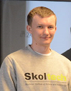
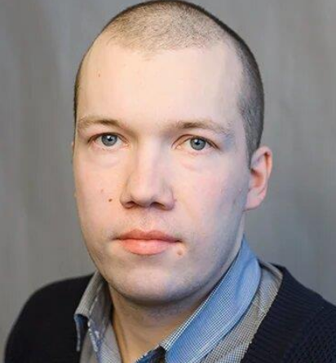
Workshop Instructors
Andrey Somov, Assistant Professor @ CDISE
Anton Stepanov, Research Engineer eSports Lab, CDISE
Dmitry Nikolaev Research Engineer eSports Lab, CDISE
Please feel free to ask questions!

Slide 5

What is eSports?
eSports = computer sport = electronic sport
eSports is an organized gaming where the single players or teams compete against each other to achieve a specific goal by the end of the game.
eSports is recognized as a sport in Russia (2016) and many other countries

Slide 6
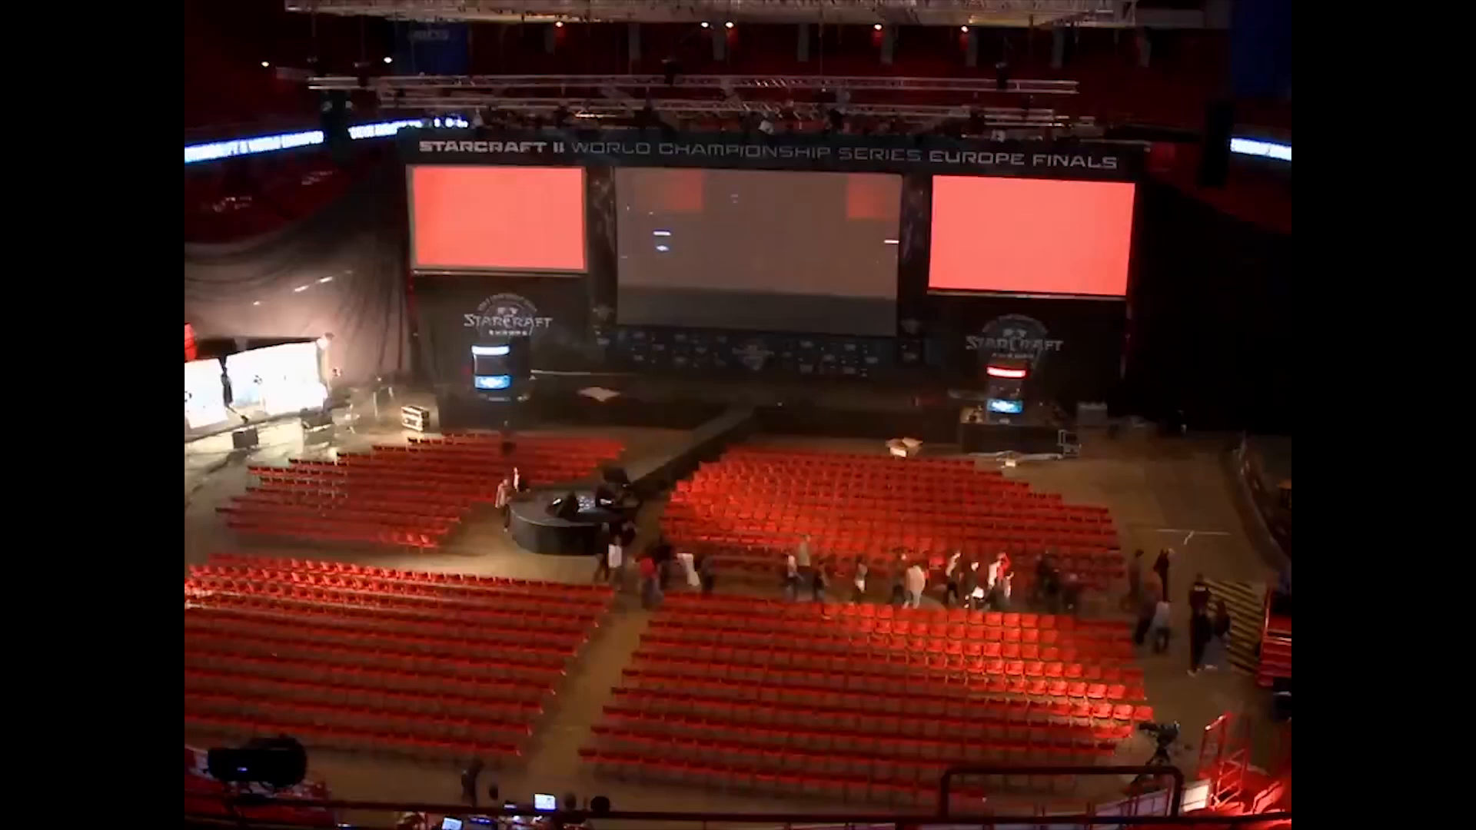
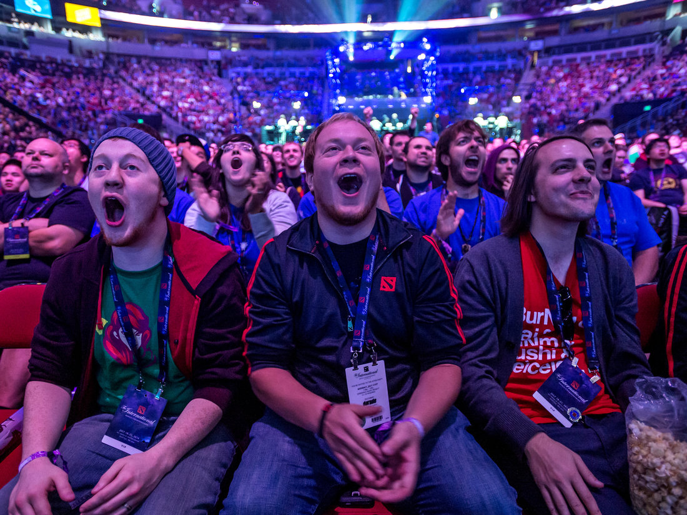
MARKET DATA eSPORTS: ENJOYING GREAT MOMENTUM
$700M
Spent in eSports
(2017)
12M
Attend live events in US & Europe
385M
Viewers & enthusiasts worldwide
$24.7M
Prize pool of the 2017 International (DOTA 2)
NEWZOO, SUPERDATA, REDEF

Slide 7
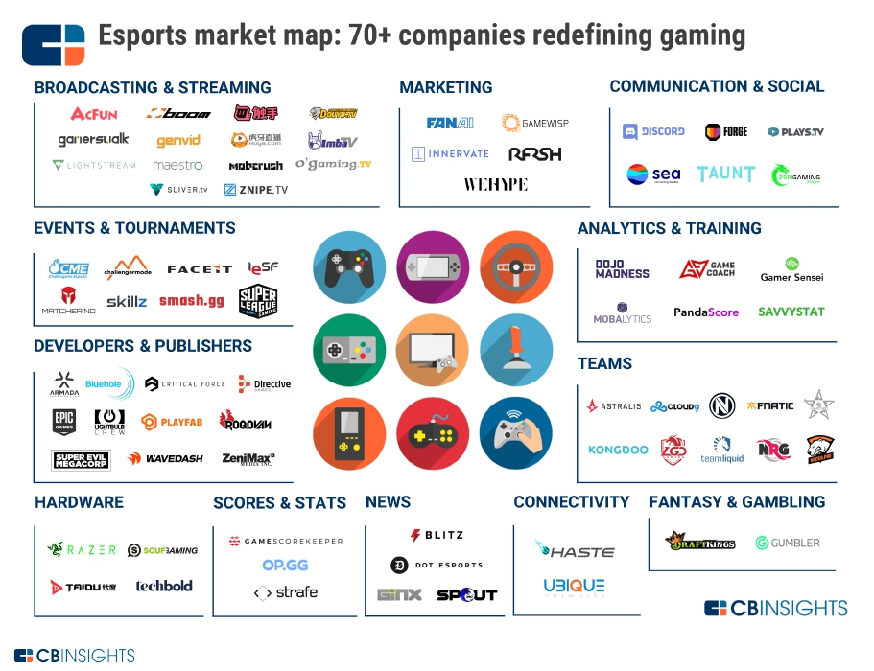
Analytics and training is the innovative e-sport category received disclosed equity financing in the last 24 months
2017 to set record of 128 deals worth nearly $2.3B

Slide 8
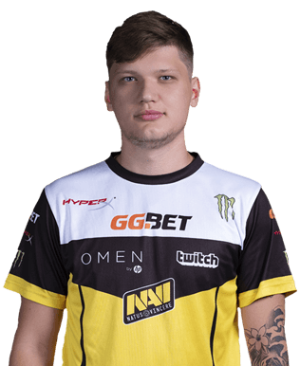
eSports Pro Player
s1mple
Аlexander Kostylev
(Natus Vincere, CS)
Sportsman – it is a player participating in semi-professional tournaments. Most players want to become a pro player.
Pro sportsman (pro player) – it is a sportsman getting salary for his gaming activity. He/she has a contract and has a professional lifestyle.
Average age of pro-players is 16-26 y.o.

Slide 9
Important Skills
CS:GO – is a team game
Development of team speak. Team speak can clearly show whether a player is a professional.
Team etiquette.
Reaction time – one of key skills (еуе tracker) .
Aim. In general, it is not that important parameter – it will not be valuable for a long prospective. It can be trained well within 1-3 months.
Sport aggression, willing to win and achieve the result.

Slide 10
There are no available tools for the eSports professional trainers to assess physical and mental conditions
of an e-athlete

Slide 11
Challenges
Games provide a very simple statistics.
Problem – lack of visual aids.
It is essential to demonstrate the player what is the best direction for further development and progress.
Team lack visual feedback and detailed analytics («I shoot perfectly – why I am not the best player?»)
Analytics:
High speed reaction in the stress situations («clatch»)
Concentration on a long time interval
Distribution of psychological resources

Slide 12
What to Do?
GOAL: Perform the performance visualization and/or analytics for eSports players using available hardware and software.
Feel free to enrich your project with your own ideas and design
NOTE: You are not limited in using extra hardware (smartphone, other sensors, etc.) or software for your project.

Slide 13
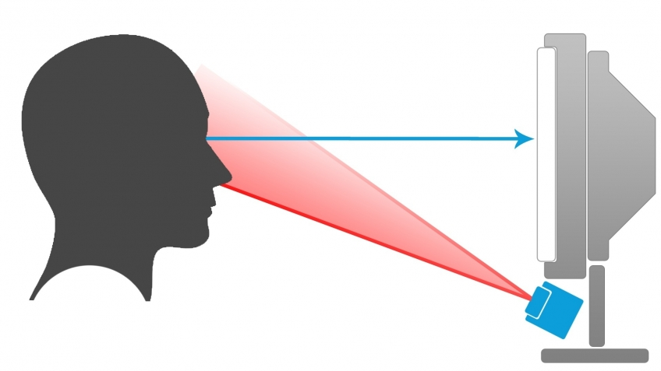

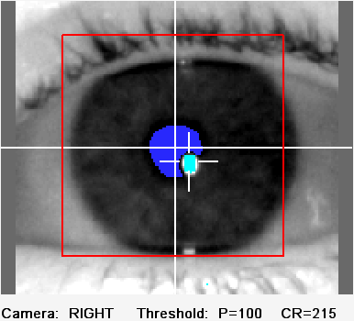
Eye-tracker
Eye tracking is the process of measuring either the point of gaze
(where one is looking) or the motion of an eye relative to the head
© EyeLink
Light, typically infrared, is reflected from the eye and sensed by
a video camera or some other specially designed optical sensor
Notes:
Немного подробнее про датчики - eye-tracker, ик излучение

Slide 14
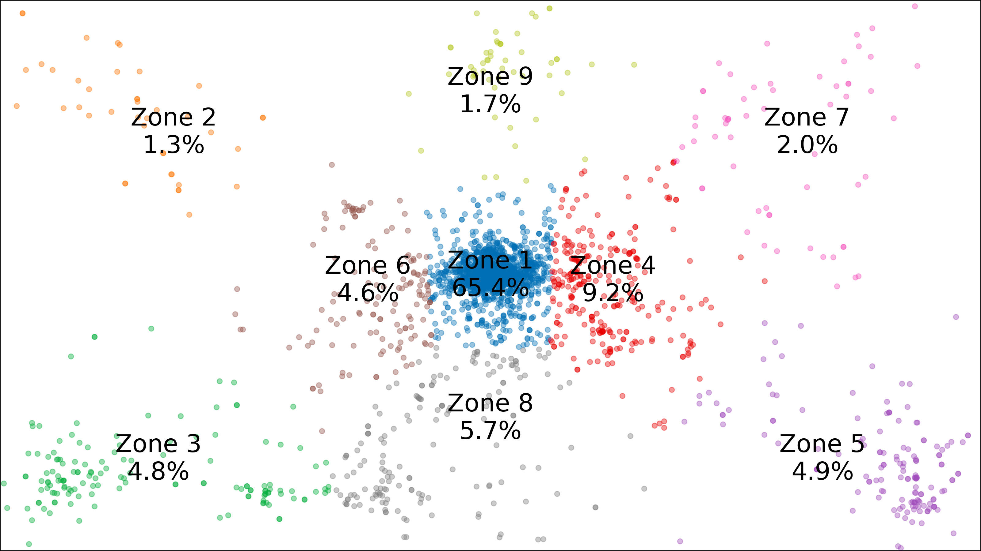
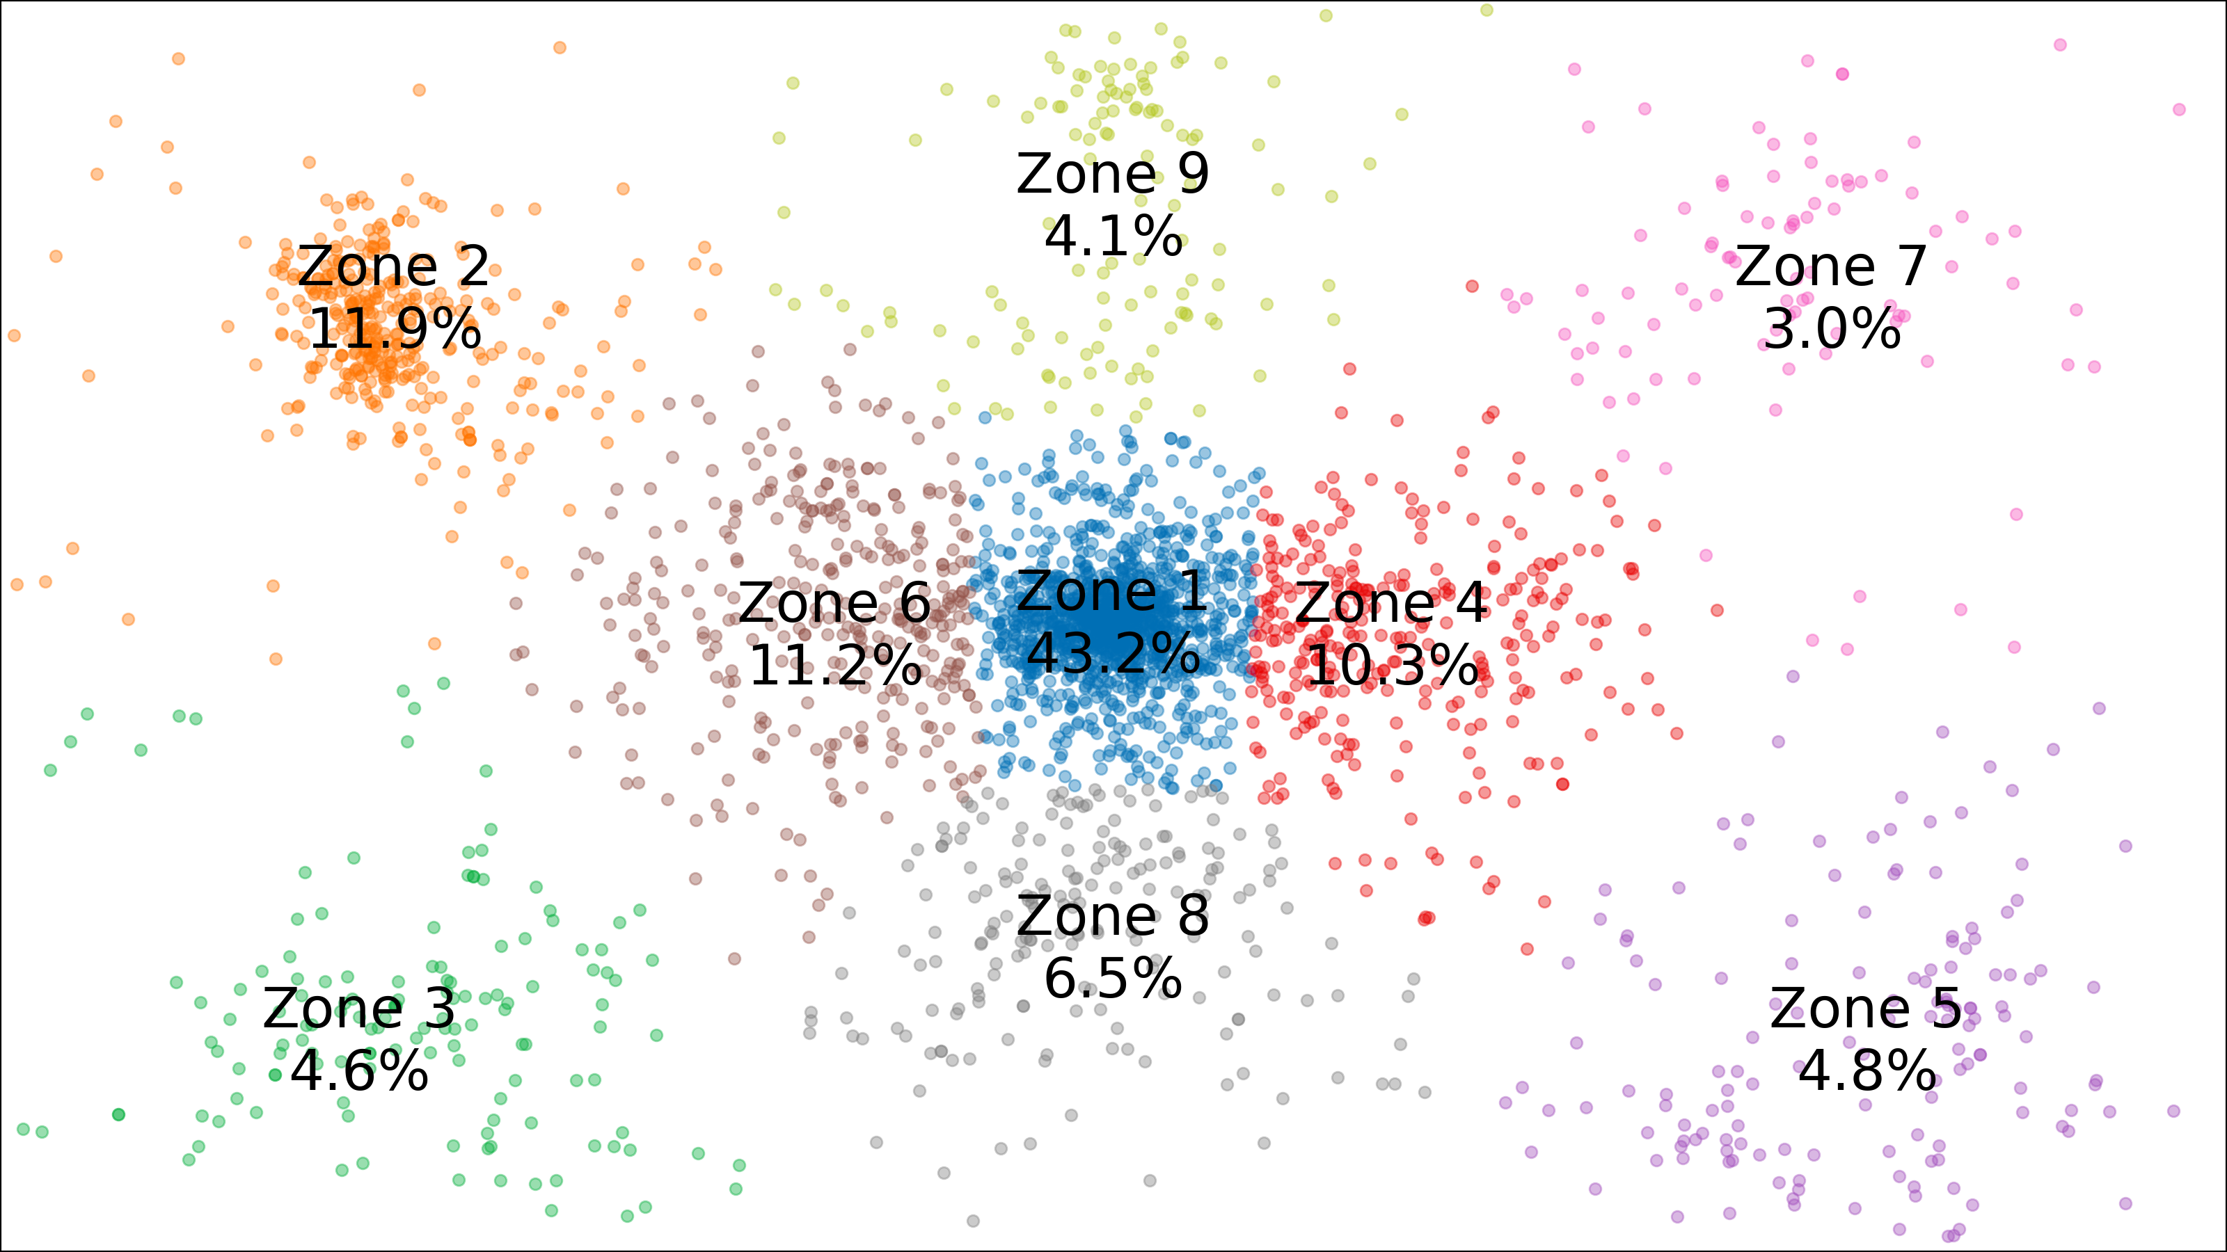
HEATMAPS
Professional Athlete
Amateur Player
Each participant is characterized by his gaze distribution vector, each component corresponds to the zone:
P = (p1, p2, …, p9)

Slide 15
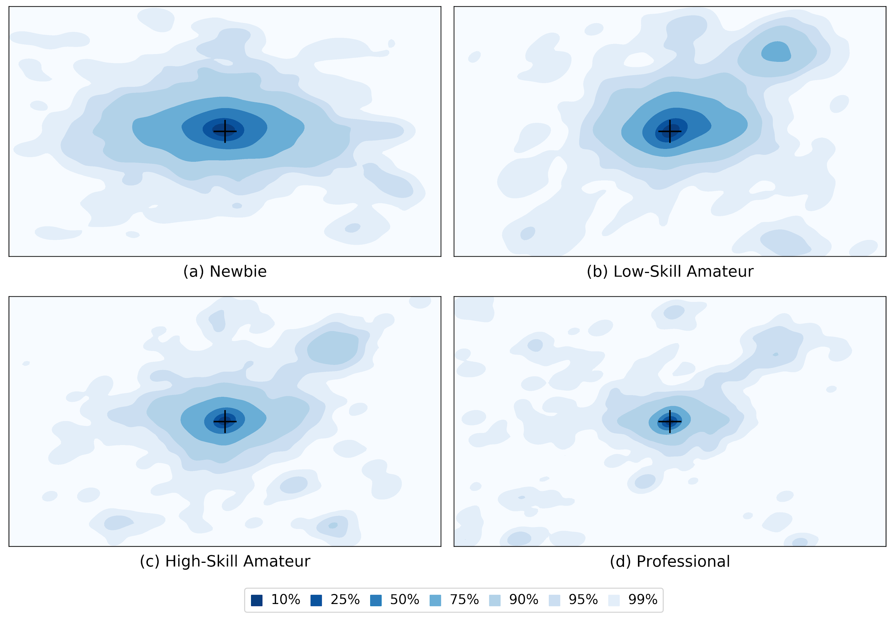
Heat-map results: newbies vs amateurs vs pros
Notes:
Полученные heatmap’s

Slide 16

CONTROL KEYS

Slide 17
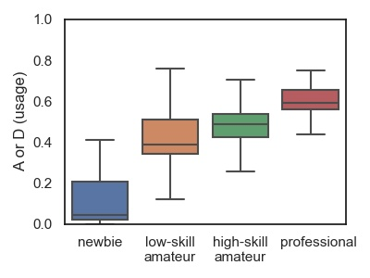
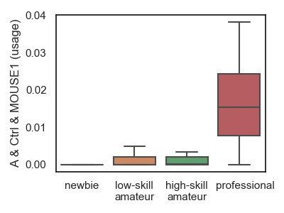
Control Keys: keyboard/mouse
Key/mouse: newbies vs amateurs vs pros
Notes:
Выделенные паттерны по клавиатуре/мыши

Slide 18
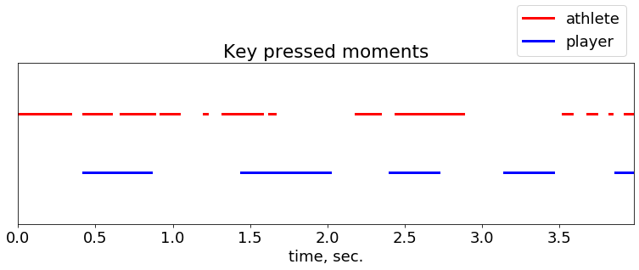
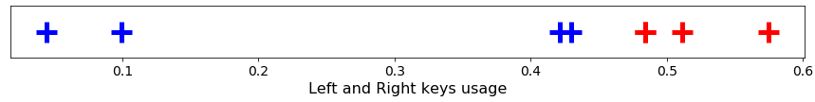
Can we measure the proficiency of Athlete
using his key dynamics?
Notes:
Here is the dynamics of any key pressings for two kinds of player proficiency over time (the dot means the key is pressed, empty space otherwise). It is from real data! What caracterizes the player and the athlete? What do you think? One simple idea is the percentage of dots in a line or the "usage". (Another idea is that the average interval length - duration is shorter for Athletes.) We can see that the "usage" of keys (here for left and right motions) separates classes good!

Slide 19
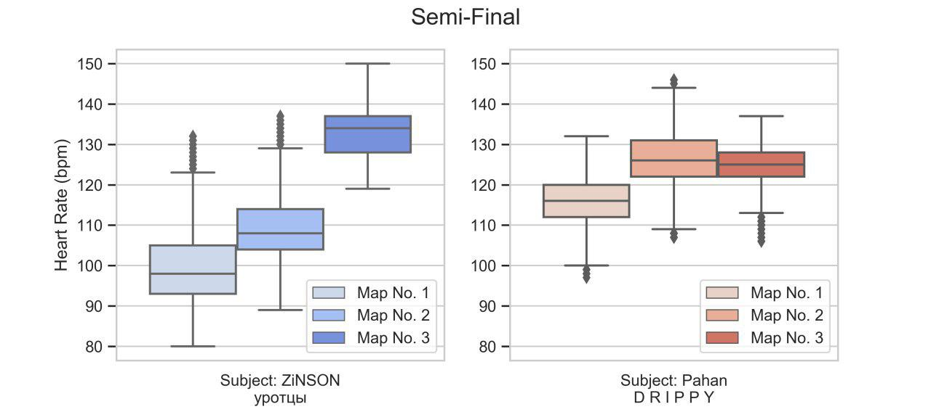
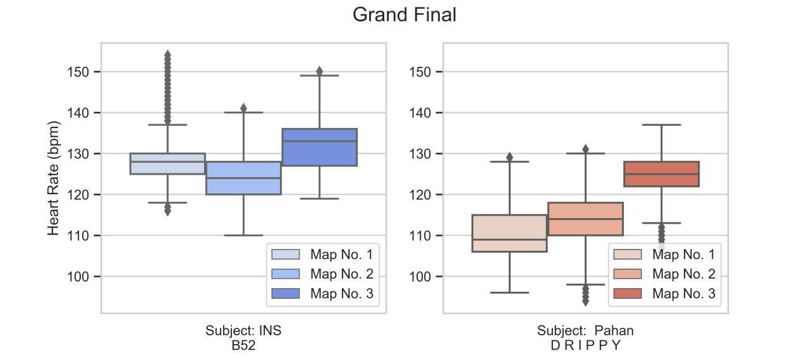
Heart Rate

Slide 20
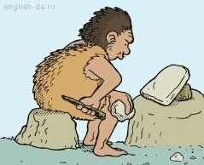


eSports Workshop Requirements
Make your project from scratch using available hardware and software resources
Work in a team, but make your personal contribution (generate ideas, brainstorming, programming, wiring, final presentation)
Team composition: 1 person with software engineering skills and 1 person with electronic engineering skills per team
English is our working language
Demonstrate your results and discuss the lessons learnt from the eSports workshop

Slide 21
Evaluation Criteria
Idea (originality, relevance)
Research (literature and internet references)
Technology (hardware, software, programming, interfaces)
Team synergy (roles distribution, balance, being positive, brain storming)
Market value (commercialization potential, scalability, market evaluation)
Clarity of presentation (figure captions (!), high-quality pics)

Slide 22
Available Resources
Eye tracker
Heart-rate sensor
IMU
Keyboard, mouse
Scripts for data collection

Slide 23
Useful Links
HLTV.org
Arxive.org
A.Somov@skoltech.ru

Slide 24
Presentation
Send your final code and presentation to a.somov@skoltech.ru by 3:30pm
Your presentation (up to 7 minutes):
What is the outcome of your project?
Lessons learnt (difficulties, unexpected bugs, fun, new skills)
Open questions.
How can you upgrade and improve your project (add new technologies, new applications)?

Slide 25
Thank you

